Slide 1
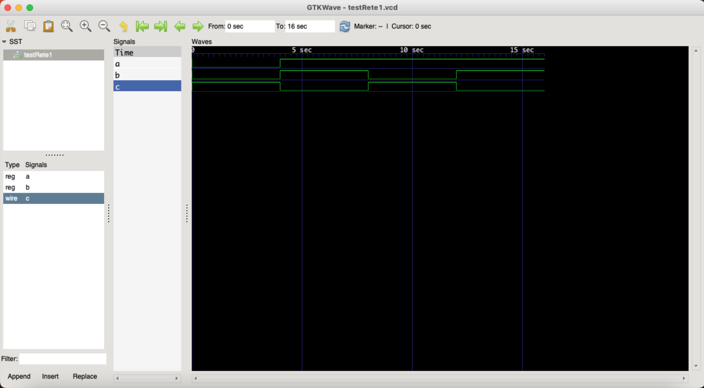
Rete1 (primitive)

Slide 2
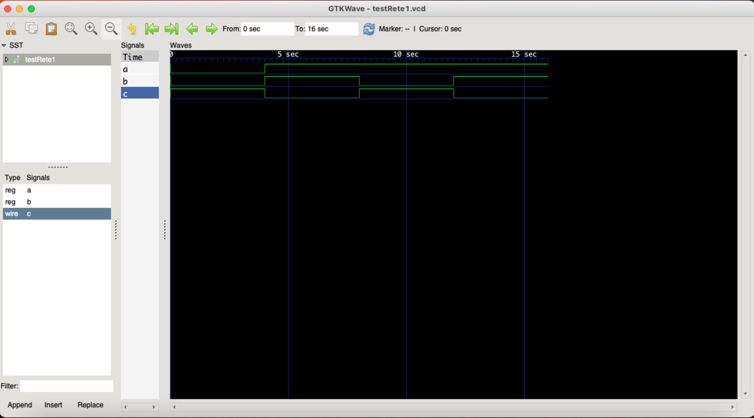
Rete1 (module)

Slide 3
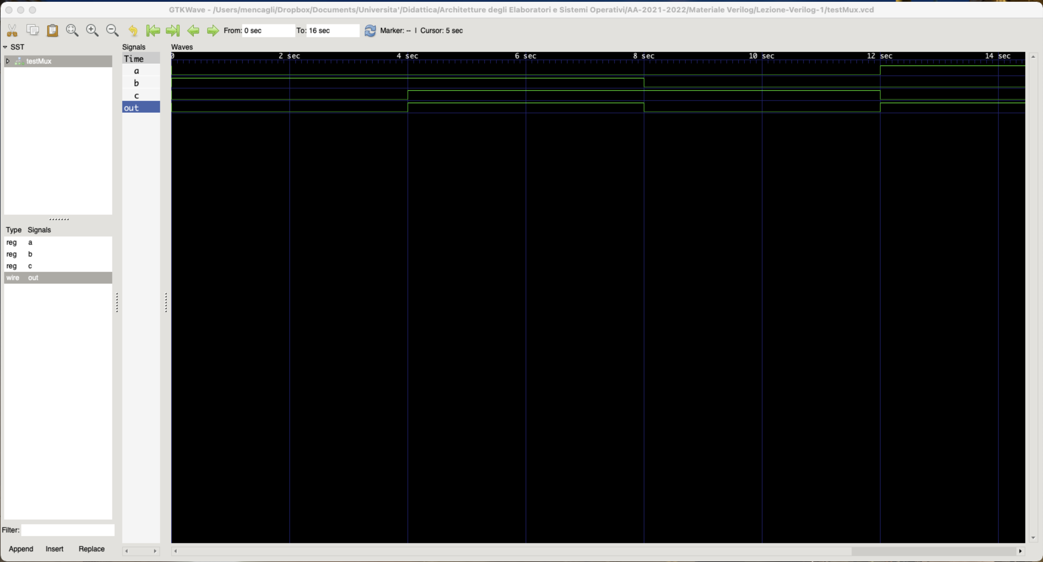
Multiplexer

Slide 4
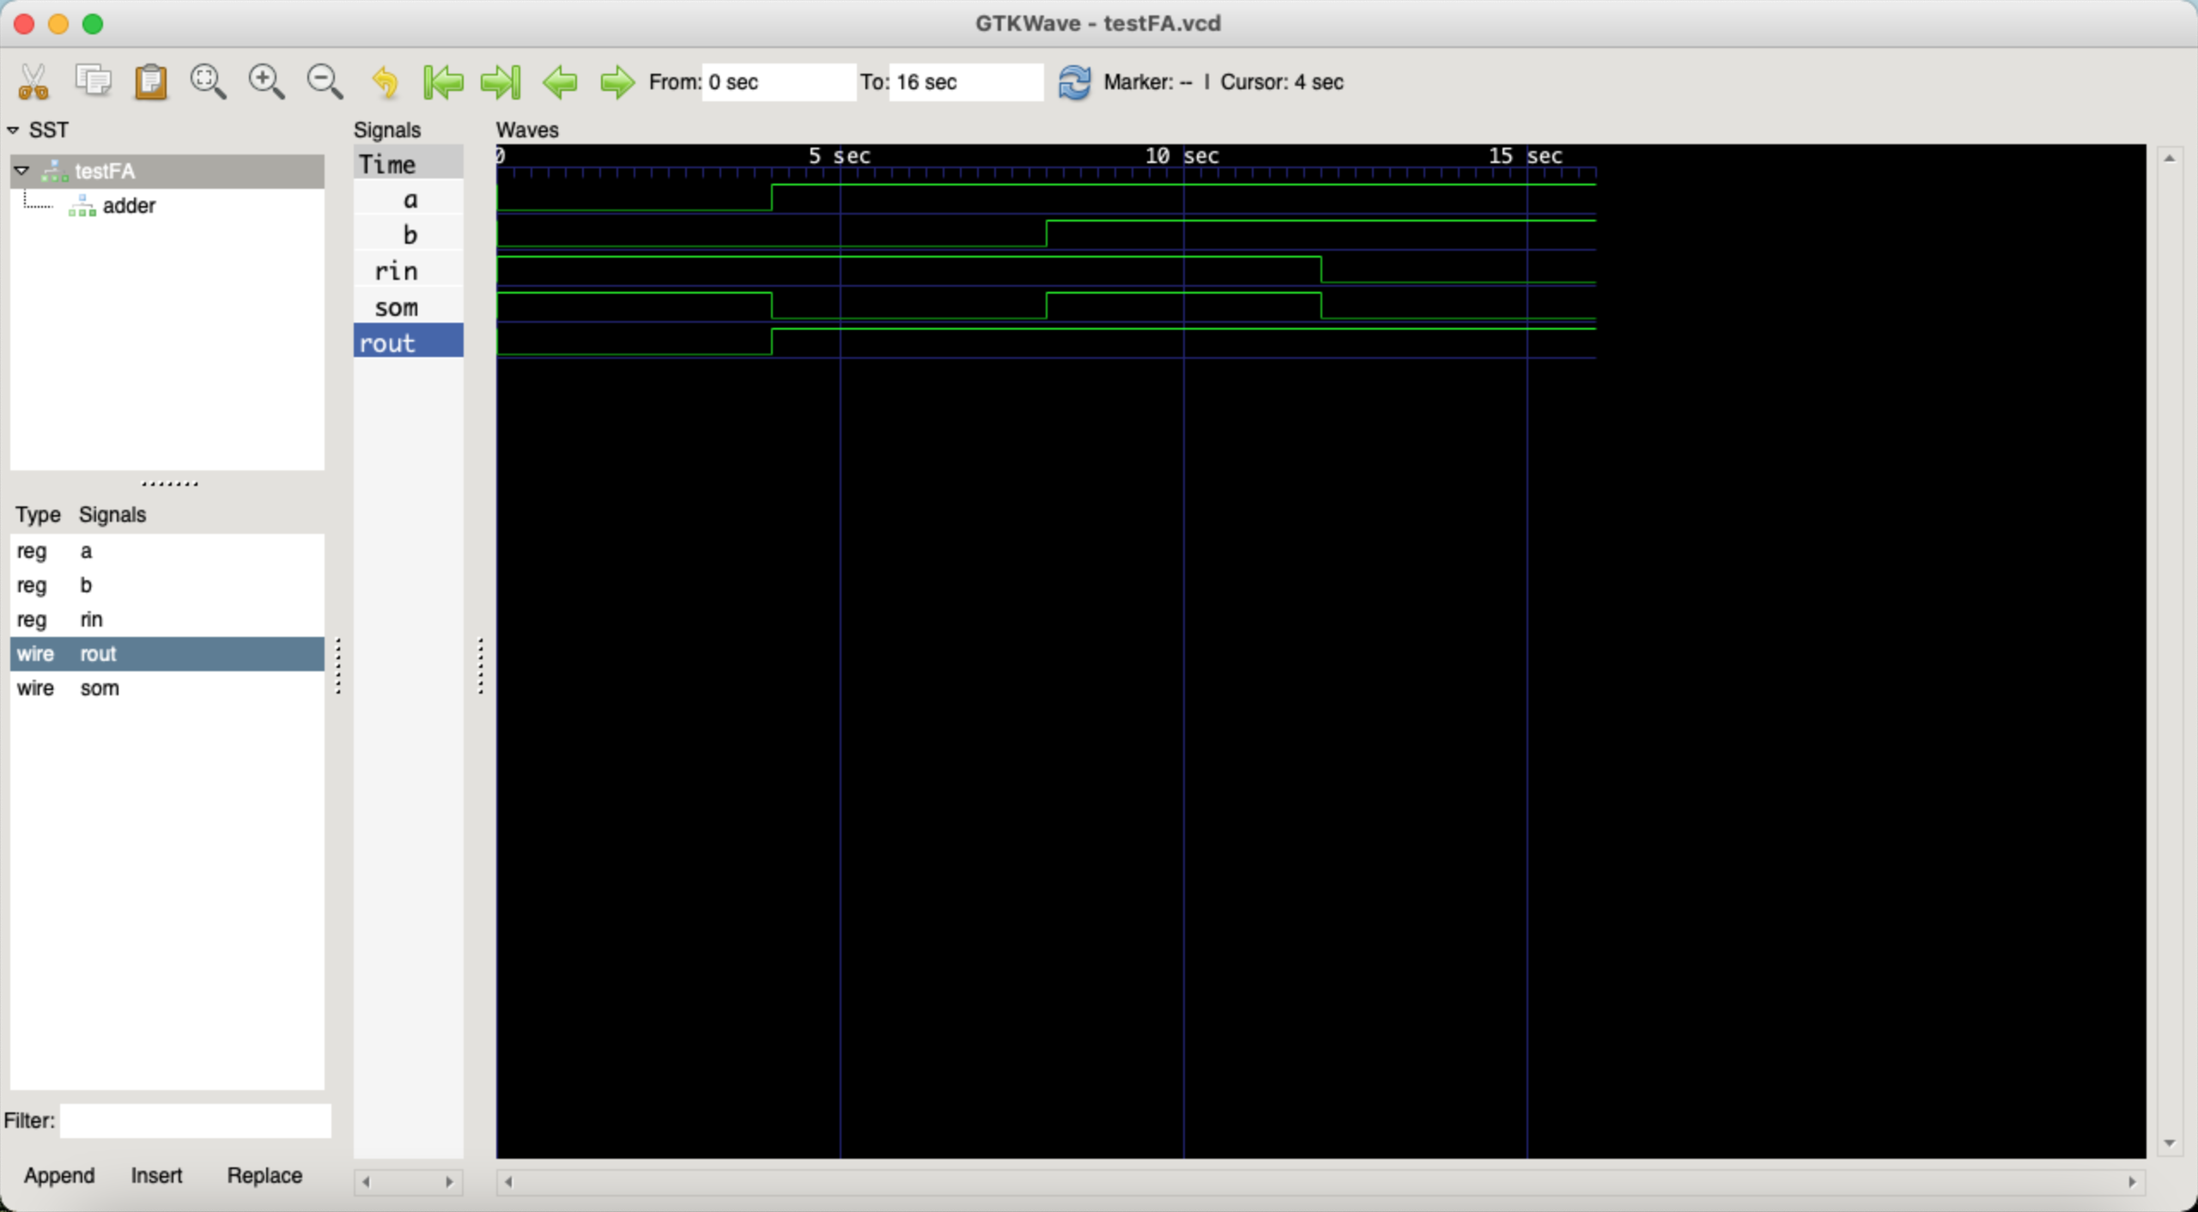
Full Adder (primitive)

Slide 5
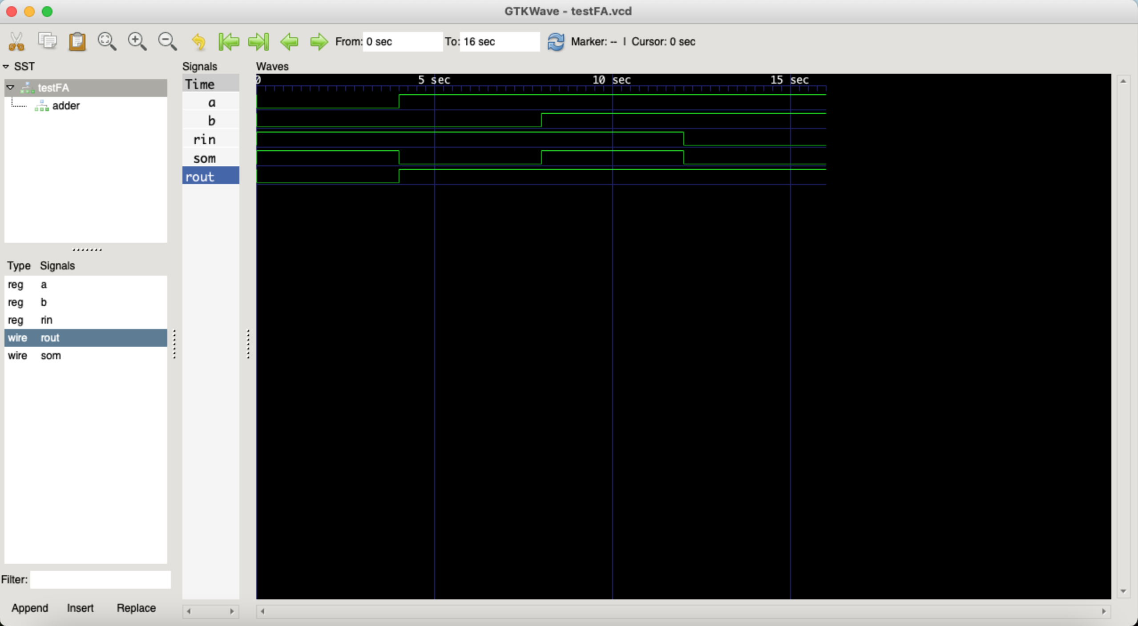
Full Adder (module)

Slide 6
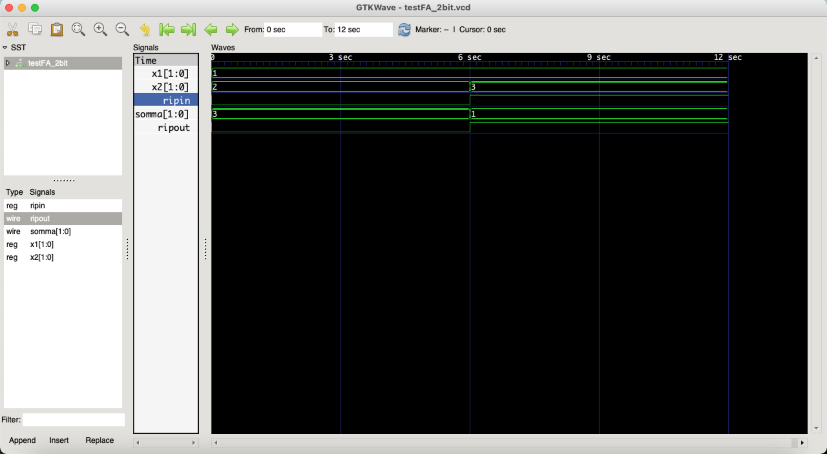
Full Adder (2 bit)

Slide 7
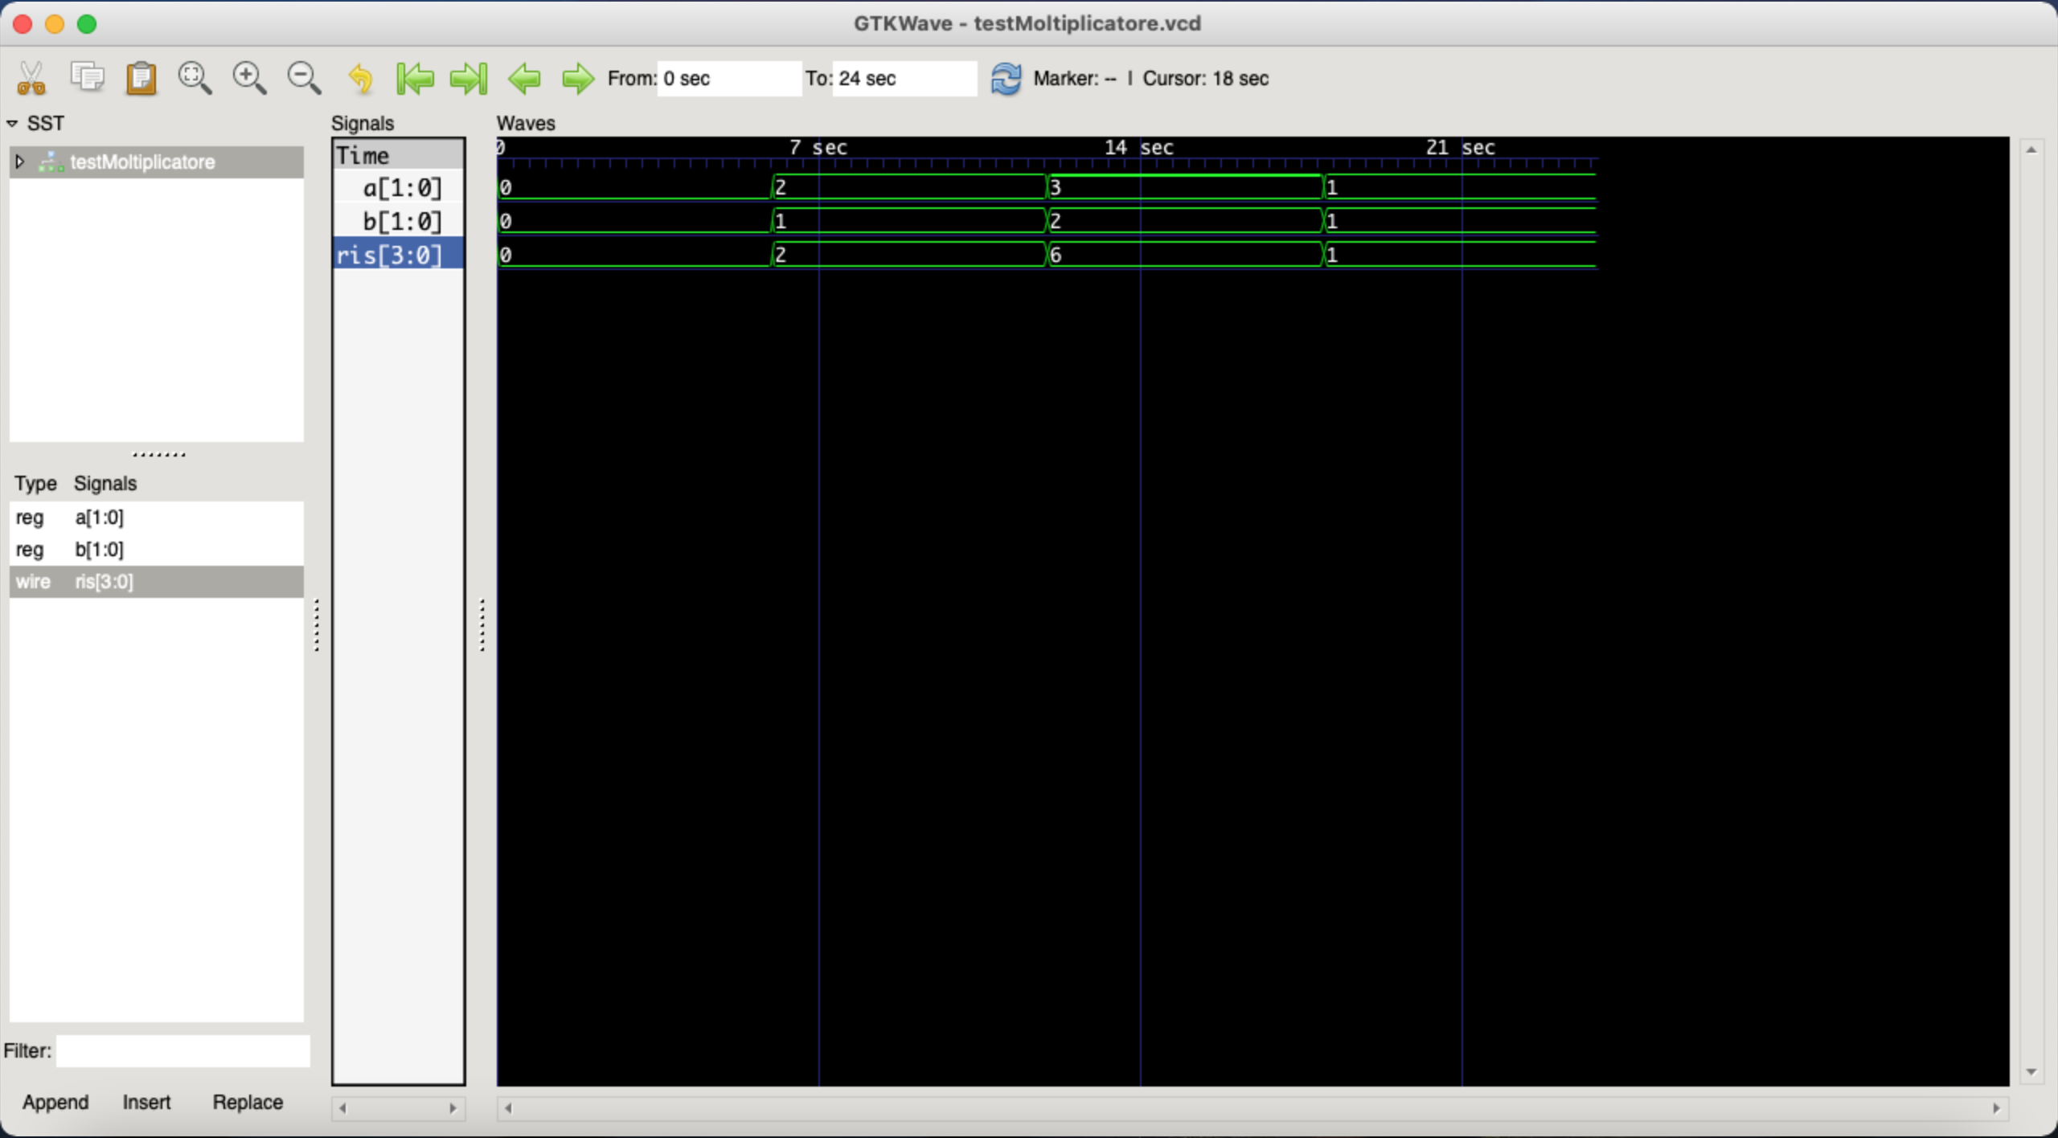
Moltiplicatore (2 bit)

Slide 8
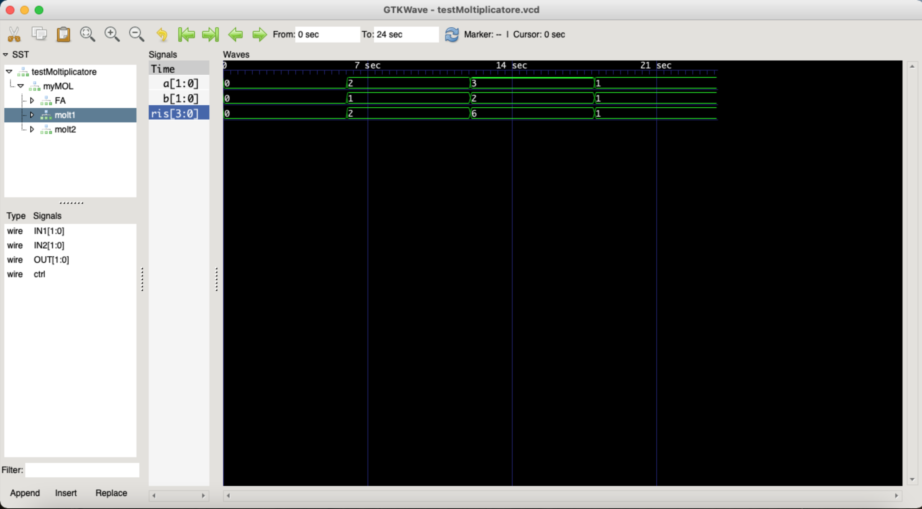
Moltiplicatore (2 bit structural)

Slide 9
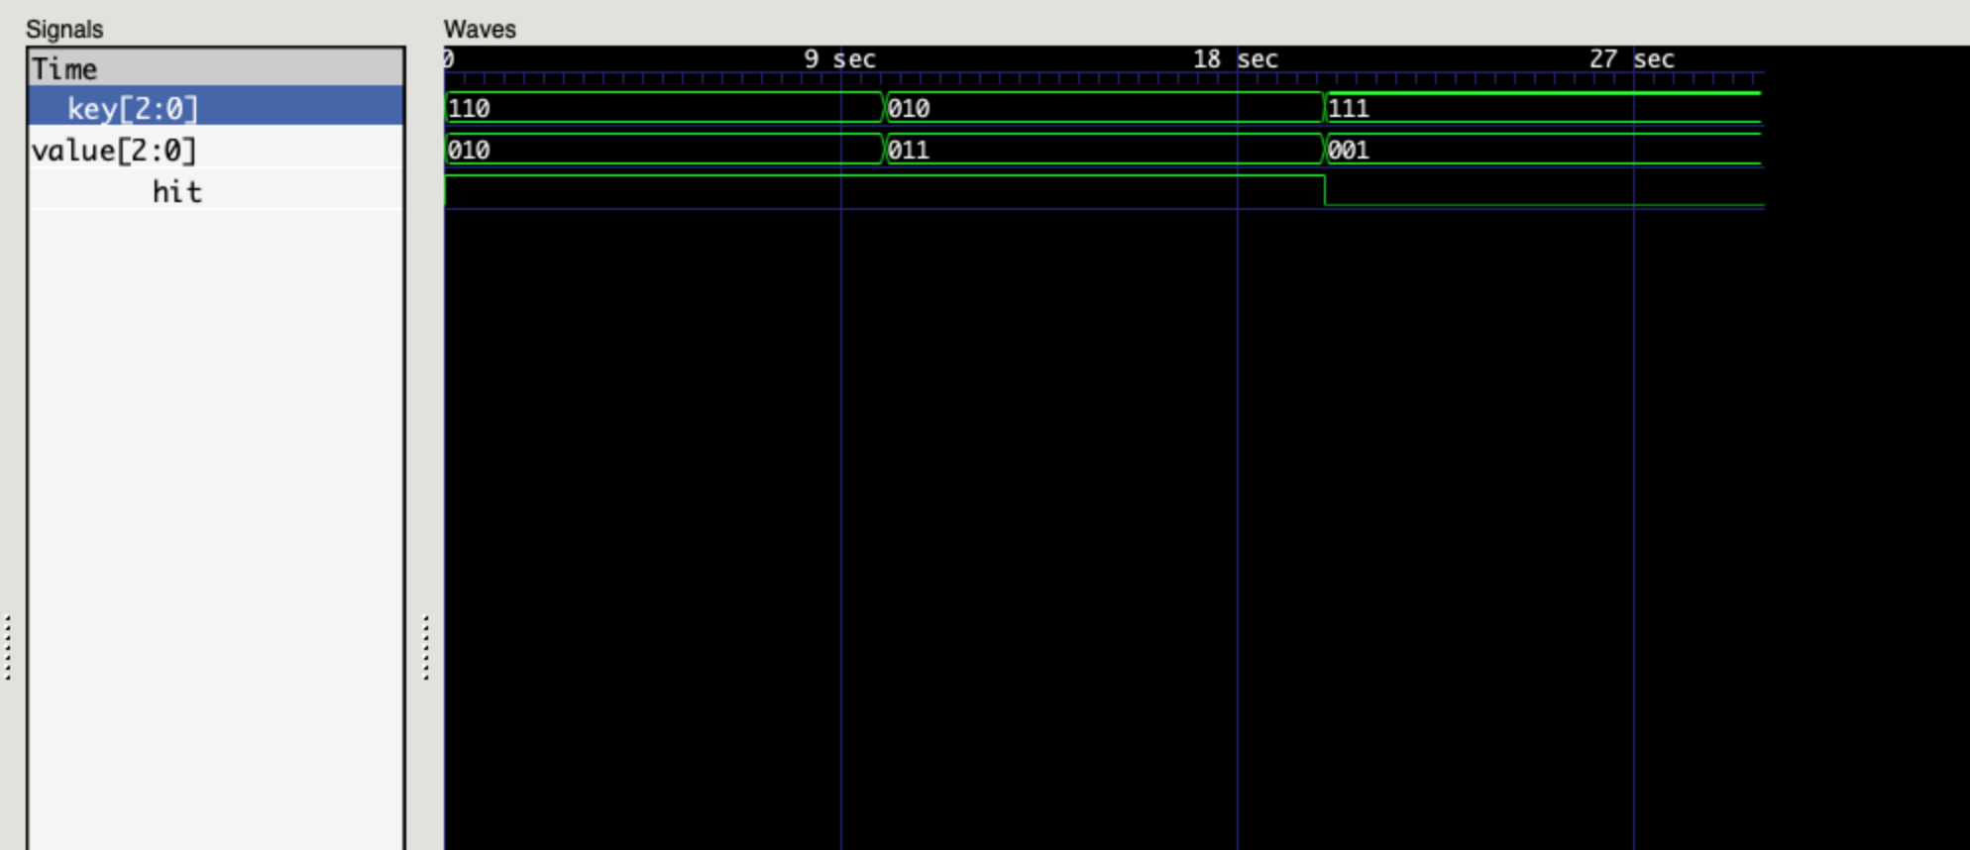
Hash Table

